Slide 1
Introduction to Computer Interfacing
CSE360 – Computer Interfacing

Slide 2
Contents
What is computer interfacing?
How does a computer work?
Software hierarchy of a computer system
Buses and Ports: Bus architectures, Tri-state logic, Bus conflicts, Glitch, Different types of ports
Microprocessor vs Microcontroller
Embedded systems vs Systems on a chip (SoC)
BIOS, Operating system vs Driver vs Firmware

Slide 3
What is computer interfacing?
An interface is a shared boundary where two or more separate components (I/O devices, Memory, etc.) of a computer system exchange information.
Types of Computer Interfaces:
Software Interface: Interaction between programs or modules (e.g., API).
Hardware Interface: Communication between hardware components (e.g., CPU, I/O devices and memory).
User Interface (UI): Where humans interact with computers (e.g., GUI or command line).
Network Interface: Where systems communicate over networks (e.g., network cards).
Examples:
Human-Machine Interface (HMI): Like touch screens or keyboards.
Peripheral Interfaces: Communication with devices like printers, mice, or storage.
Software Interfaces: APIs allowing programs to interact (e.g., REST, SOAP).

Slide 4
Peripheral Devices & Communication Links
Peripheral Communication Links:
Peripherals connected to a computer require special communication links to interface with the CPU.
Input-output interfaces are hardware components that manage data transfers between the CPU and peripherals.
Major Differences:
Peripheral devices are electromagnetic/electro-mechanical, while the CPU is electronic, often requiring signal conversion.
Peripheral data transfer rates are slower, requiring synchronization with the CPU.
Data formats differ between peripherals and the CPU, requiring format conversion.
Each peripheral device has its own operating mode, which must be managed to avoid disturbing other devices.

Slide 5
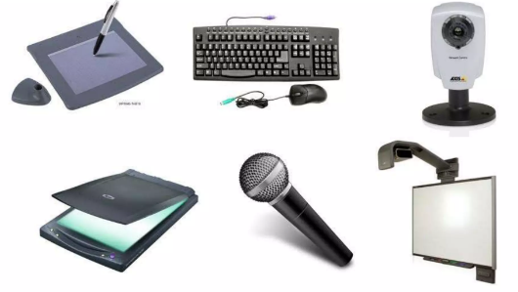
Types of Peripheral Devices
A peripheral is a device connected to a host computer that expands its capabilities but is not part of the core architecture.
It can be partially or completely dependent on the host for operation.
Types of Peripheral Devices:
Input Devices: Devices that send data to the computer (e.g., keyboard, mouse).
Output Devices: Devices that receive data from the computer (e.g., monitor, printer).
Input/Output Devices: Devices that both send and receive data (e.g., external hard drives).

Slide 6
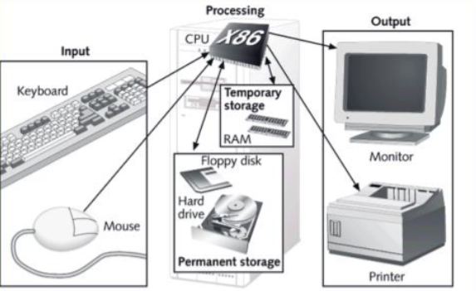
How does a computer work?
Functions of a Computer-
Input
Processing
Output
Storage

Slide 7
How does a computer work?
Input
Data entered through devices like Keyboard, Mouse, Scanner.
Can be analog (e.g., microphone) or digital (e.g., keyboard).
Processing
Handled by the CPU (Central Processing Unit), the computer's brain.
Performs calculations and controls tasks.
RAM (Memory) provides temporary storage for fast access.
Output
Results displayed on output devices such as Monitor, Printer, Speakers
Forms of output: visual, printed, or audio.
Storage
Processed information saved in HDD/SSD, Cloud Storage.
Stored as files, images, or databases.

Slide 8
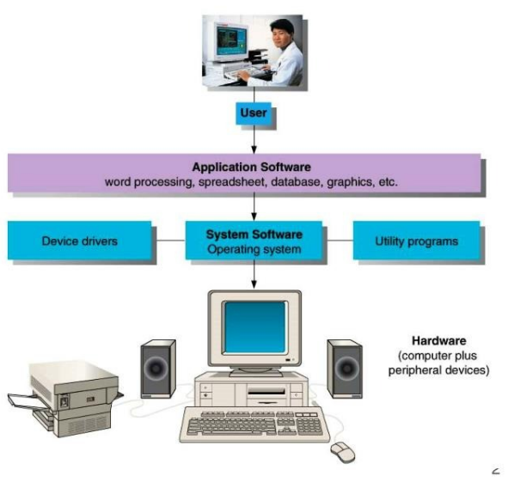
Software hierarchy of a computer system

Slide 9
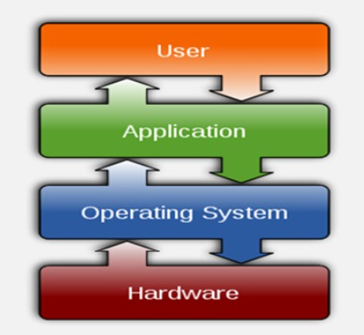
Software hierarchy of a computer system
User
The person interacting with the computer, using various applications for tasks such as word processing, spreadsheets, or graphics.
Application Software
Programs used by the user to perform specific tasks, including:
Word Processing, Database Management, Graphics.
System Software
Manages the overall functioning of the computer:
Operating System (OS): Controls hardware and provides services to application software.
Device Drivers: Facilitate communication between the OS and hardware devices.
Utility Programs: Perform maintenance tasks like virus scanning and disk cleanup.
Hardware
The physical components of the computer (e.g., monitor, keyboard, CPU, speakers), along with peripheral devices like printers.

Slide 10
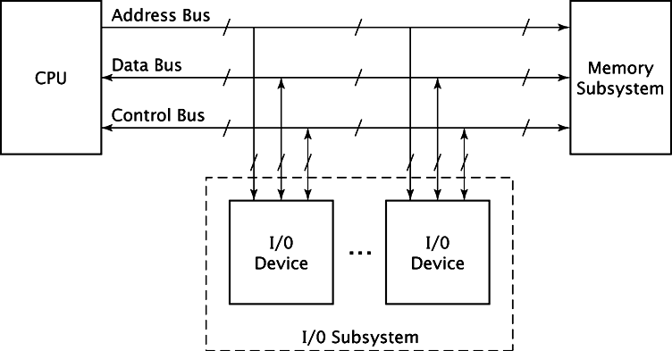
BUS Architecture
A bus architecture is a system of pathways used for communication between components inside a computer. It transfers data, addresses, and control signals.
Key Components:
CPU: The central processing unit that sends and receives data.
Memory: Where data is stored for quick access.
I/O Devices: Devices like keyboards, printers, etc., that interact with the CPU.

Slide 11
System Bus
A set of wires that interconnects all the components (subsystems) of a computer system.
Data Flow:
Source Component: Outputs data onto the bus.
Destination Component: Inputs data from the bus.
Bus Hierarchy:
Address, Data, and Control Buses: Used to access memory and I/O controllers.
I/O Controller: Second set of buses connects the I/O controller to attached devices (e.g., peripherals).
Example: PCI Bus: A common local bus example used in many computer systems.
Notes:
‹#›

Slide 12
Address Bus
The CPU reads/writes data by addressing a unique location. The location is output onto the address bus, and the memory uses it to access the proper data.
Unique Addresses:
Each I/O device (e.g., monitor, keyboard) has its own unique address.
CPU places the address on the address bus when accessing an I/O device, and the correct device acts accordingly.
Uni-Directional:
Data flows only from the CPU to the address bus.
The CPU never reads data from the address bus.

Slide 13
Data Bus
Transfers actual data between the CPU, memory, and I/O devices.
Data Transfer Process:
CPU Fetches:
CPU outputs address on the address bus.
Memory outputs data onto the data bus.
CPU reads the data from the data bus.
CPU Writes:
CPU outputs address on the address bus.
CPU outputs data onto the data bus.
Memory reads the data and stores it.
Bidirectional: - Data can flow to and from the CPU.

Slide 14
Control Bus
The control bus is a collection of individual control signals, unlike address and data buses that transmit n-bit values.
Signals:
Read/Write Signals: Whether data is being read into or written out of the CPU.
Memory/I/O Signals: Whether the CPU is accessing memory or an I/O device.
Ready Signals: Whether the I/O device or memory is ready for data transfer.
Unidirectional: - Control signals can flow to and from the CPU for synchronization between the CPU and other components like memory and I/O devices.

Slide 15
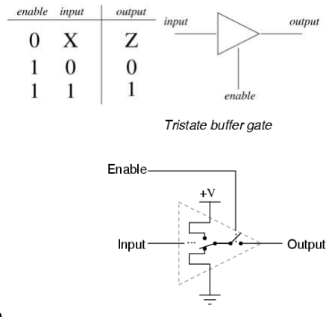
Tri- state Logic
Tri-state logic allows a bus to be shared by multiple devices but ensures that only one device can access the bus at any given time.
Three States:
Logic 0: Represents a low voltage signal (e.g., 0V).
Logic 1: Represents a high voltage signal (e.g., 5V).
High Impedance (Hi-Z): This is the third state where the device is effectively disconnected from the circuit and does not influence the bus.

Slide 16
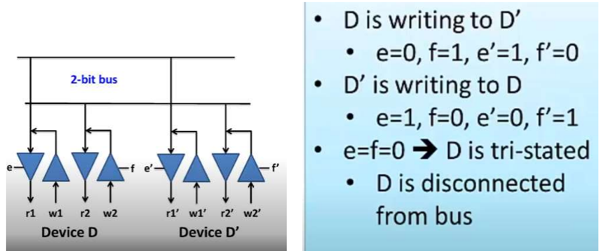
How Tri-Stating works
When a device is in the Hi-Z state, it acts as though it is disconnected, preventing interference with other devices on the bus.
This enables multiple devices to be connected to the same bus but ensures that only one device is active at a time.

Slide 17
Advantages of Tri-State Bus
To resolve conflict between multiple sources driving the shared bus line.
To use the same port as both for input and output operation.
Note: not all devices need to drive all bus lines.
It higher the bus fan out.

Slide 18
Bus Interfacing
Bus Master: The device that controls communication on the bus, determining who will speak and who will listen.
The CPU is typically the bus master.
Advanced buses can allow other devices to become bus masters when necessary.
Input/Output Operations:
READ: Data moves into the bus master (input).
WRITE: Data moves out from the bus master (output).
Bus Lines:
Each bus has several lines dedicated to three main functions:
Addressing
Data Transfer
Control

Slide 19
Bus Errors and Conflicts
Bus Conflict: Occurs when multiple I/O devices try to use the bus simultaneously as output.
No Conflict: If one device is used as output and others as input, no bus error occurs.
Causes of Bus Errors:
Multiple devices using the bus as output at the same time.
Wait states not being properly maintained (mismatch between speeds).
An I/O device causing a bus pin to get stuck at 1 or 0.
Glitches: Short-lived faults that may cause transient errors.

Slide 20
Wait States & Glitches
Wait State: A time-out period when the CPU or bus lies idle to account for components working at different speeds.
Necessary when the CPU is faster than the memory or other components.
Without proper wait states, synchronization issues can lead to bus errors.
Glitches: A temporary fault that is self-correcting but can cause errors like signal transitions at the wrong time.
Example: In I2C bus systems, glitches can cause incorrect start commands to be detected, disrupting communication.

Slide 21
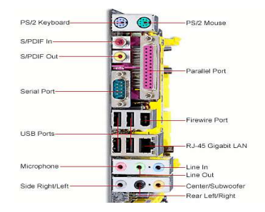
Computer Ports
Computer ports are connection points or interfaces with other peripheral devices.
There are two main type of computer ports:
Parallel Ports
Serial Ports
Others types are also there • PS2, SCSI etc.

Slide 22
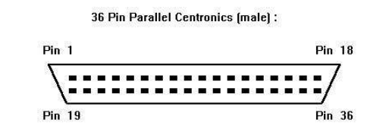
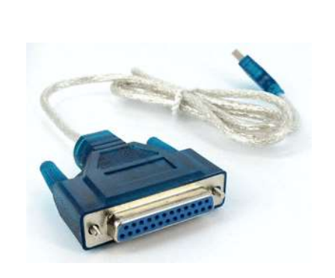
Parallel Port
Used for data transfer between a computer and peripheral device through a 25 or 36 pin connector.
Transfers multiple bits at a time in parallel communication.
With IEEE 1284 standard, it supports bidirectional data transfer.
Speed ranges from 50 KBPS to 150 KBPS, and up to 2 MBPS with EPP and ECP modes.

Slide 23
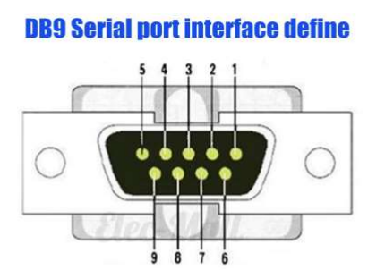
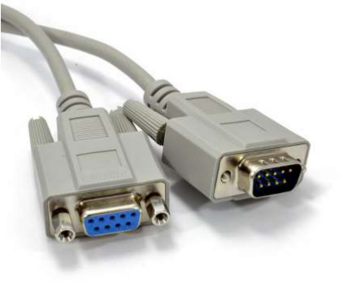
Serial Port
Serial port transfers data one bit at a time.
Along with parallel port, it was commonly used for data transfer between computers and peripherals.
Nowadays, it has been replaced by ports like USB, VGA, and Ethernet for more efficient communication.

Slide 24
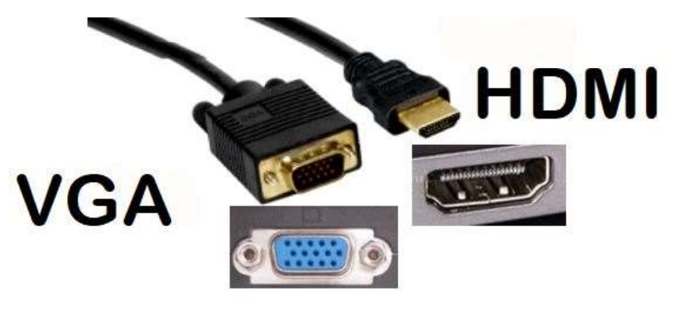
VGA and HDMI Ports
VGA (Video Graphics Array) and HDMI (High-Definition Multimedia Interface) are interface standards used to connect devices (laptops, DVD players) to displays (TVs, monitors, projectors).
VGA carries only video signals.
HDMI is the standard for newer devices like Blu-Ray players and LED TVs, carrying both video and audio.

Slide 25
VGA Port
VGA uses a 15-pin connector, usually marked in blue.
It is an analog video standard, developed for older computer displays.
VGA can only carry a single video signal.
Maximum resolution: 2048×1536, though at higher resolutions, image quality may degrade with ghosting and other issues.

Slide 26
HDMI Port
HDMI is a digital interface that supports both video and audio.
It uses a 19-pin connector (HDMI A is the most common type).
Supports high-definition resolutions without interference or signal loss.
HDMI is more versatile, also carrying audio and, in newer versions, internet.
HDMI includes encryption technology like HDCP for protecting data.

Slide 27
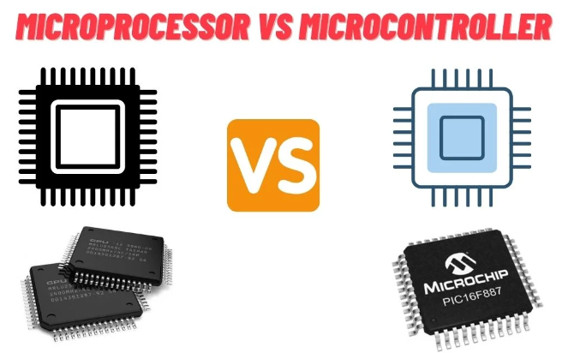
Microcontroller: A compact integrated circuit designed to govern a specific operation in an embedded system. It typically contains a processor, memory, and I/O peripherals on a single chip.
Microprocessor: A general-purpose processing unit that only includes a CPU. It requires external components like memory, I/O ports, etc., to function.

Slide 28
Microprocessor VS Microcontroller
Architecture:
Microcontroller: Combines a CPU, memory (RAM, ROM), and I/O peripherals all on a single chip.
Microprocessor: Contains only the CPU; requires external components like RAM, ROM, and I/O interfaces for functioning.
Purpose:
Microcontroller: Designed for specific control-oriented applications, often used in embedded systems.
Microprocessor: Used in general-purpose computing systems like personal computers and servers for high-performance tasks.
Power Consumption:
Microcontroller: Consumes less power and is ideal for battery-powered or energy-efficient devices.
Microprocessor: Consumes more power as it handles complex computations and tasks.

Slide 29
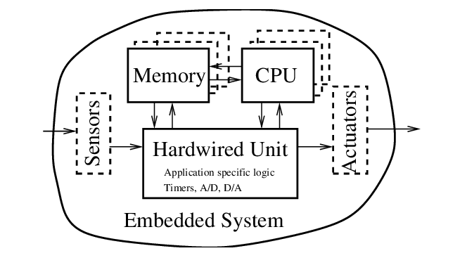
Embedded System
A specialized computing system designed to perform dedicated tasks within a larger system.
Components:
CPU
Memory
Hardwired Unit: Performs application-specific tasks like timing, A/D or D/A conversions.
Sensors & Actuators: Sensors collect data from the environment. Actuators take actions based on processed data.
Key Features:
Designed for specific tasks.
Real-time performance.
Compact and power-efficient.

Slide 30
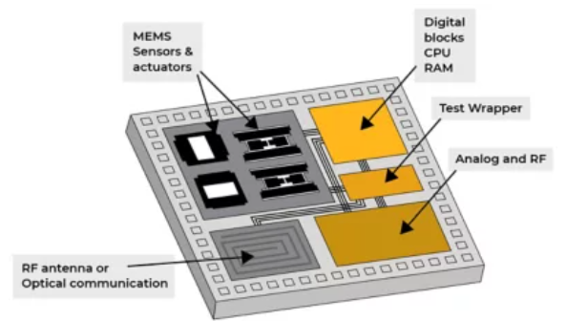
Systems on a chip (SoC)
A highly integrated circuit that combines all essential components of a computing system (CPU, GPU, memory, I/O, etc.) on a single chip.
Components Integrated:
Sensors & Actuators:
Digital Blocks: Contains CPU and RAM for processing tasks.
Analog and RF Blocks: Handles communication and signal conversion for wireless and analog communication.
Key Features:
Combines multiple functionalities (processing, communication, sensing) in one chip.
Power-efficient, compact, and cost-effective design for modern devices.
Widely used in smartphones, IoT devices, smart wearables, and embedded systems.

Slide 31
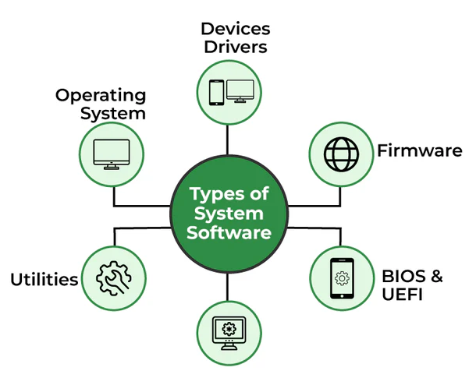
System Softwares

Slide 32
System Softwares
BIOS (Basic Input/Output System)
Initializes and tests hardware during startup (POST).
Loads the bootloader/OS from disk.
Located on motherboard ROM/Flash memory.
Operating System (OS)
Manages hardware resources and runs applications.
Provides an interface between users and hardware.
Examples: Windows, Linux, macOS.

Slide 33
System Softwares
Driver
Software that helps the OS communicate with hardware.
Enables devices like printers, GPUs, and keyboards to function.
Examples: Graphics card, network adapter drivers.
Firmware
Low-level software stored in hardware (ROM).
Controls device functions (e.g., hard drives, keyboards).
Semi-permanent, rarely updated compared to drivers.

Slide 34
References
“Computer Systems Organization & Architecture”, John D. Carpinelli, ISBN: 0-201-61253-4
“Operating Systems – A modern perspective”, Garry Nutt, ISBN 0-8053-1295-1

